Slide 1
Chapter 3 Processor Management

Slide 2
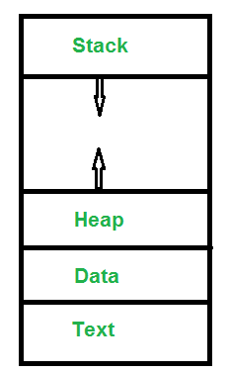
Processor Management
A process is a program in execution. For example, when we write a program in C or C++ and compile it, the compiler creates binary code. The original code and binary code are both programs. When we actually run the binary code, it becomes a process.
A process is an ‘active’ entity, as opposed to a program, which is considered to be a ‘passive’ entity. A single program can create many processes when run multiple times; for example, when we open a .exe or binary file multiple times, multiple instances begin (multiple processes are created).

Slide 3
Text Section:A Process, sometimes known as the Text Section, also includes the current activity represented by the value of the Program Counter.
Stack: The Stack contains the temporary data, such as function parameters, returns addresses, and local variables.
Data Section: Contains the global variable.
Heap Section: Dynamically allocated memory to process during its run time.

Slide 4
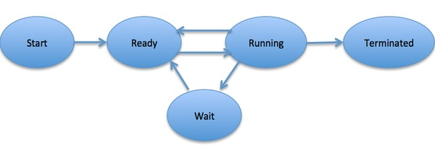
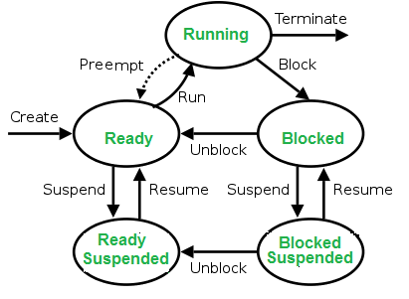
Process State

Slide 5
New: Newly Created Process (or) being-created process.
Ready: After creation process moves to Ready state, i.e. the process is ready for execution.
Run: Currently running process in CPU (only one process at a time can be under execution in a single processor).
Wait (or Block): When a process requests I/O access.
Complete (or Terminated): The process completed its execution.
Suspended Ready: When the ready queue becomes full, some processes are moved to suspended ready state
Suspended Block: When waiting queue becomes full.
Context Switching The process of saving the context of one process and loading the context of another process is known as Context Switching. In simple terms, it is like loading and unloading the process from running state to ready state.
Process Control Block (PCB)
A Process Control Block is a data structure maintained by the Operating System for every process. The PCB is identified by an integer process ID (PID).

Slide 6
Operation on Processes
1) Process Creation : -
Process creation is a task of creating new processes. There are different situations in which a new process is created. There are different ways to create new process.
A new process can be created at the time of initialization of operating system or when system calls such as fork () are initiated by other processes.
The process, which creates a new process using system calls, is called parent process while the new process that is created is called child process.
The child processes can create new processes using system calls. A new process can also create by an operating system based on the request received from the user.
The process creation is very common in running computer system because corresponding to every task that is performed there is a process associated with it
2) Process termination : -
Process termination is an operation in which a process is terminated after the execution of its last instruction. This operation is used to terminate or end any process. When a process is terminated, the resources that were being utilized by the process are released by the operating system. When a child process terminates, it sends the status information back to the parent process before terminating.

Slide 7
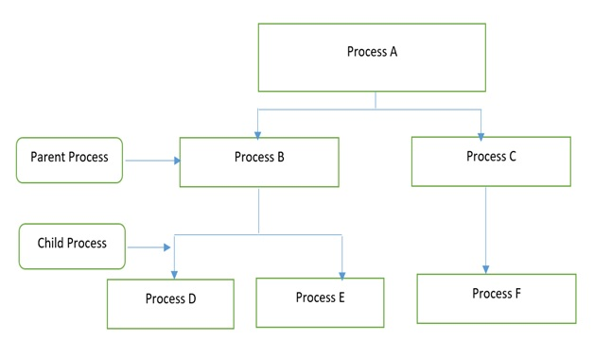
The above figure shows the hierarchical structure of processes.
The termination of a process when all its instruction has been executed successfully is called normal termination. However, there are instances when a process terminates due to some error. This termination is called as abnormal termination of a process.

Slide 8
THREAD
A thread is also called a lightweight process. Threads provide a way to improve application performance through parallelism. Threads represent a software approach to improving performance of operating system by reducing the overhead thread is equivalent to a classical process.
A thread shares with its peer threads few information like code segment, data segment and open files. When one thread alters a code segment memory item, all other threads see that.
Each thread belongs to exactly one process and no thread can exist outside a process. Each thread represents a separate flow of control. Threads have been successfully used in implementing network servers and web server. They also provide a suitable foundation for parallel execution of applications on shared memory multiprocessors.
Types of Thread
User Level Threads − User managed threads.
Kernel Level Threads − Operating System managed threads acting on kernel, an operating system core.

Slide 9
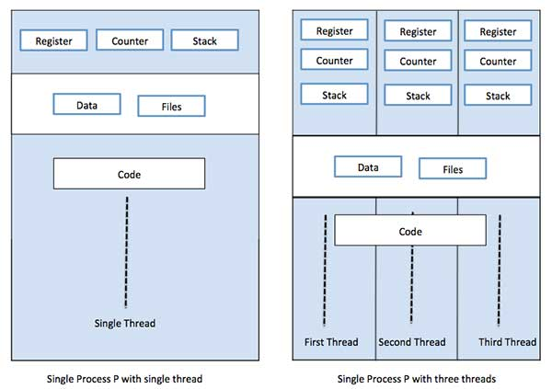
THREAD

Slide 10
USER LEVEL THREAD | KERNEL LEVEL THREAD
User thread are implemented by users. | kernel threads are implemented by OS.
OS doesn’t recognized user level threads. | Kernel threads are recognized by OS.
Implementation of User threads is easy. | Implementation of Kernel thread is complicated.
Context switch time is less. | Context switch time is more.
Context switch requires no hardware support. | Hardware support is needed.
If one user level thread perform blocking operation then entire process will be blocked. | If one kernel thread perform blocking operation then another thread can continue execution.
Example : Java thread, POSIX threads. | Example : Window Solaris.

Slide 11
Difference between Process and Thread
S.N. | Process | Thread
1 | Process is heavy weight or resource intensive. | Thread is light weight, taking lesser resources than a process.
2 | Process switching needs interaction with operating system. | Thread switching does not need to interact with operating system.
3 | In multiple processing environments, each process executes the same code but has its own memory and file resources. | All threads can share same set of open files, child processes.
4 | If one process is blocked, then no other process can execute until the first process is unblocked. | While one thread is blocked and waiting, a second thread in the same task can run.
5 | Multiple processes without using threads use more resources. | Multiple threaded processes use fewer resources.
6 | In multiple processes each process operates independently of the others. | One thread can read, write or change another thread's data.

Slide 12
CPU Scheduling

Slide 13
Link
https://www.geeksforgeeks.org/gate-notes-operating-system-process-management-introduction/
https://www.tutorialspoint.com/operating_system/os_processes.htm
https://www.includehelp.com/operating-systems/process-operations-in-operating-system.aspx

